Slide 1
Wiring diagram for Obstacle Avoiding Robot

Slide 2
Wiring Diagram for Autonomous Robot
Using the robot from previous project
Add servo motor and ultrasonic sensor

Slide 3
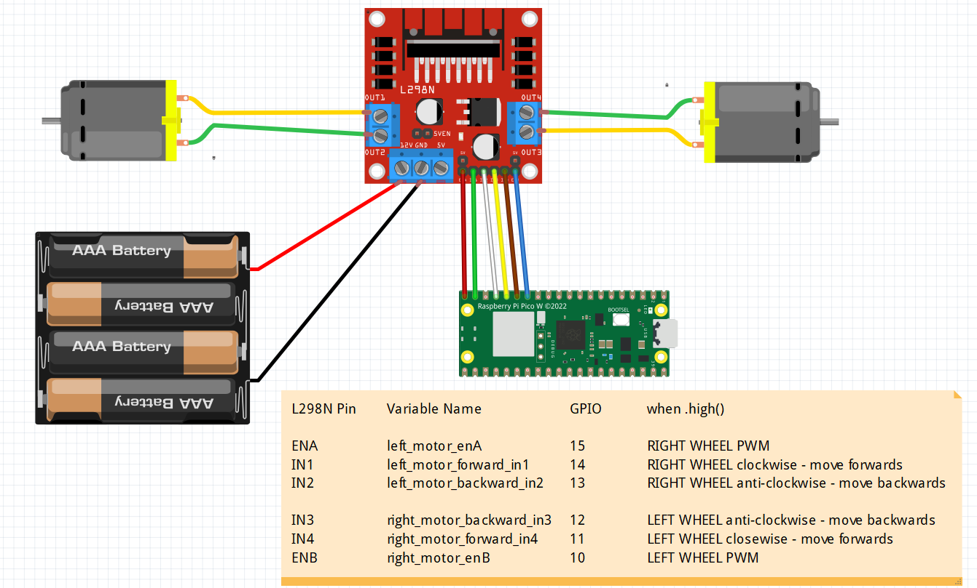
PINS ON THE LN298
ENA
Left wheel Throttle
Left Motor Forward
Right Motor Forward
ENB
Right wheel Throttle
Left Motor Backward
Right Motor Backward
on
LEFT
RIGHT

Slide 4
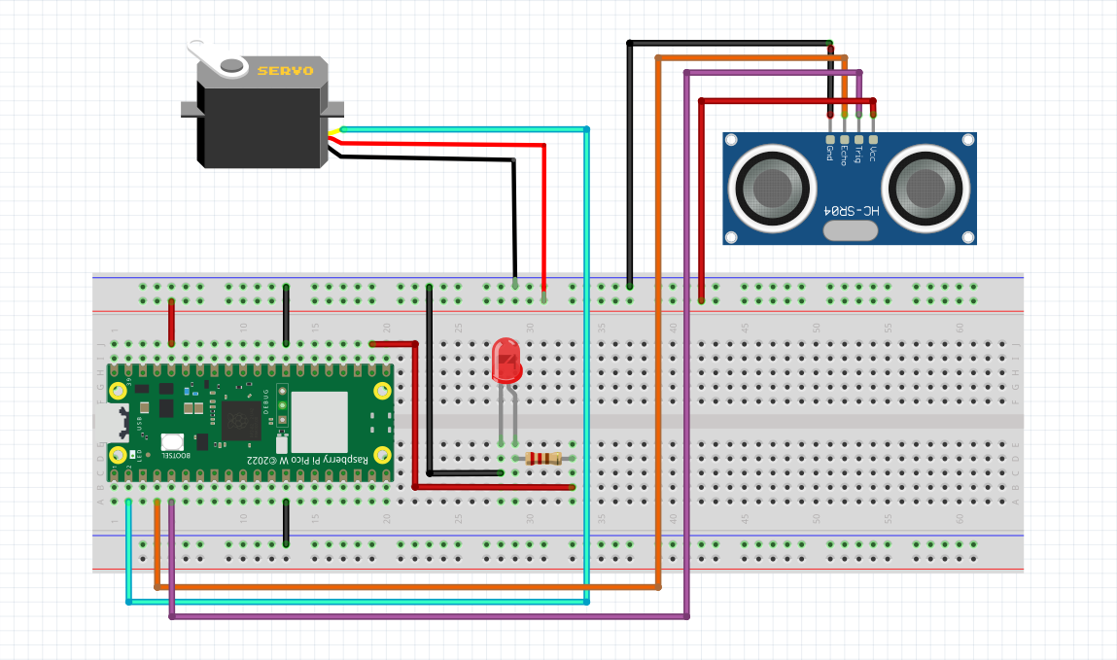
To be added to previous robot to form an autonomous robot
VCC can be connected
To VBU (5V) as well

Slide 5
Finding the middle position of servo motor
calibrateservo.py

Slide 6
How to calibrate the Servo
The servo motor is used to position the Ultrasonic Sensor mounted on it
When the robot is moving forward, the servo must place the ultrasonic sensor pointing in the forward direction of the robot.
This is the position 90 degrees (using the micropython-servo package)
Before the ultrasonic sensor is mounted, we need to get the 90 degree position of the servo.
Program : calibrateservo.py

Slide 7
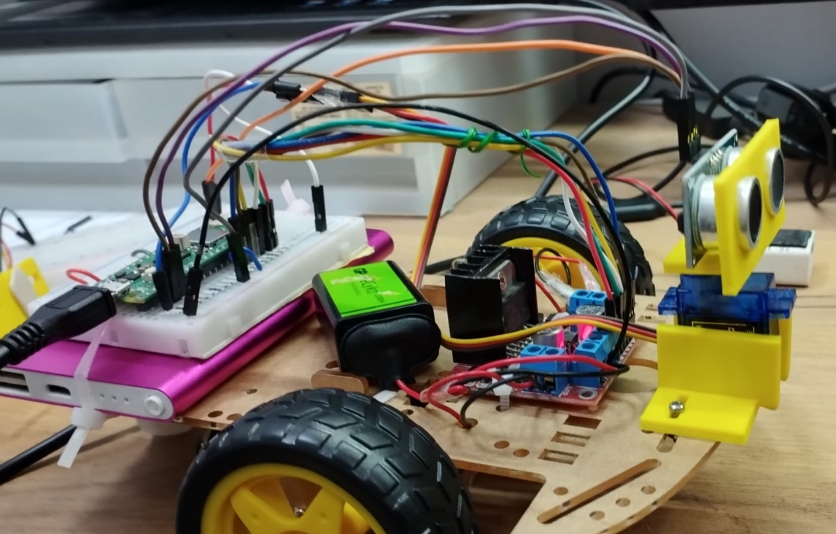

Slide 8
import time
from servo import Servo
my_servo = Servo(pin_id=1)
my_servo.write(0) #extreme left
time.sleep(2.0)
my_servo.write(30)
time.sleep(2.0)
my_servo.write(60)
time.sleep(2.0)
my_servo.write(90) #middle position
time.sleep(2.0)
my_servo.write(120)
time.sleep(2.0)
my_servo.write(150)
time.sleep(2.0)
my_servo.write(180) #extreme right position
time.sleep(2.0)
my_servo.write(90) #middle position
Refer to calibrateservo.py
We need to find the 90 degrees position before we mount the ultrasonic sensor on the servo motor

Slide 9
Testing the ultrasonic sensor
calibratehcsr04.py

Slide 10
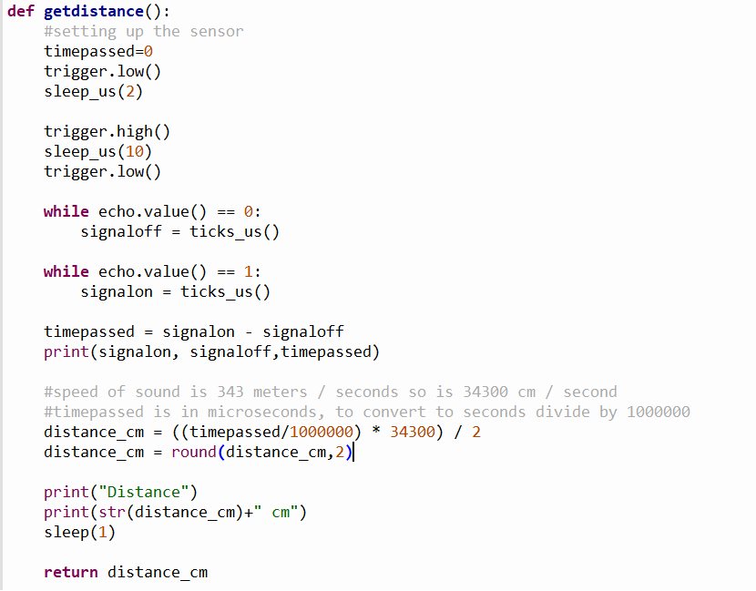
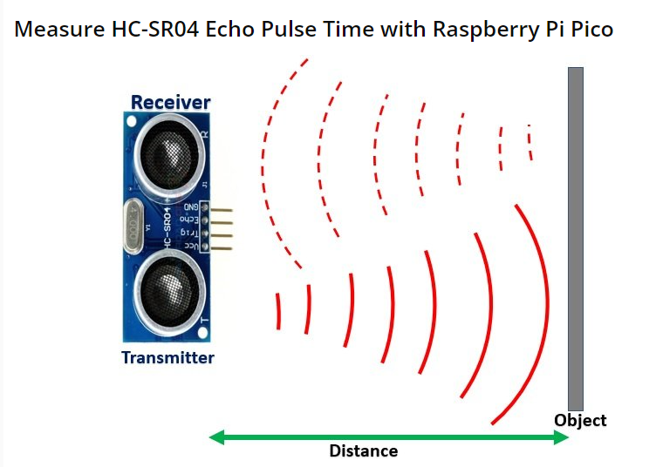
Testing accuracy of HCSR04 Ultrasonic Sensor
calibratehcsr04.py
3
1
Echo Pin goes low and remains low until signal returns. Time just before echo == 1 is taken (start point)
2
2
Echo Pin remains high until the entire pulse is received by the receiver. (End Time)
It will then go low or == 0
1
3
4
The diff is the duration
timepassed
5
Compute distance
distance=time x speed of sound
6
speed of sound is 343 meters / seconds so is 34300 cm / second
timepassed is in microseconds, to convert to seconds divide by 1000000

Slide 11
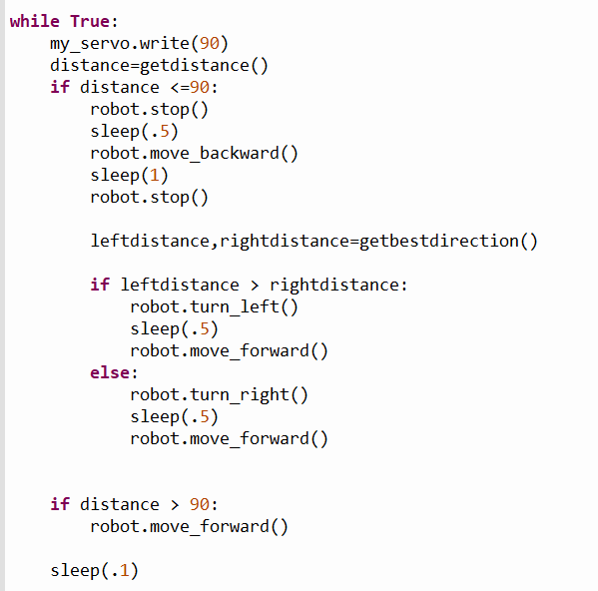
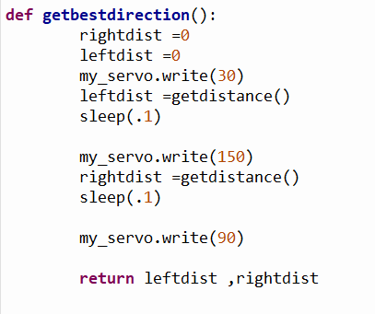

Modify robbywithclass.py to become an obstacle avoiding robot autorobot.py
Duty cycle of the motor driver

Slide 12
Not the most effective method
Robot has to pause to get distance – not ideal
Multithreading

